Slide 1
Employee Data Analysis using Excel
STUDENT NAME: SHRAVANTI NANDA
REGISTER NO: 312209464
DEPARTMENT: B.COM (ACCOUNTING AND FINANCE)
COLLEGE: ANNA ADARSH COLLEGE FOR WOMEN

Slide 2

PROJECT TITLE
Employee Performance Analysis using Excel

Slide 3



AGENDA
AGENDA
1.Problem Statement
2.Project Overview
3.End Users
4.Our Solution and Proposition
5.Dataset Description
6.Modelling Approach
7.Results and Discussion
8.Conclusion
3/21/2024 Annual Review

Slide 4
PROBLEM STATEMENT
A problem statement for employee performance can be a clear and concise explanation of a challenge or issue that summarizes what needs to be changed. It can help stakeholders, team members, and you focus on the problem, who it impacts, and why it's important

Slide 5

PROJECT OVERVIEW
Analysing the performance of employee by considering various factors like gender, performance level, ratings, achievents.
The employee database contains various attributes such as employee ID, Name, Department, Job title, Starting date , Employee type (full-time / part-time) , Employee status (voluntarily terminated , active , etc).

Slide 6

WHO ARE THE END USERS?
Primary users
Secondary users
Tertiary users
Employees (receive feedback and development plans)
Managers/Supervisors (evaluate performance and make decisions)
HR Department (monitor trends, identify training needs, and develop strategies)
Organizational Leadership (evaluate performance management systeem and make strategic decisions.)
Succession Planning Teams (identify and develop future leaders)
Compensation and Benefits Teams(determine rewards and recognition)
Training and Development Teams (design and deliver training program)

Slide 7
OUR SOLUTION AND ITS VALUE PROPOSITION
Conditional formatting- Used to highlight the required columns
Filter- To remove the blanks
Formula-To find the performance level
Pivot table- To summarize the data
Graph- Data visualization

Slide 8
Dataset Description
Employee data - from Kaggle
It has 26 features
I’ve taken 10 features
Employee ID - in number
Name -Text
Employee type - Text
Performance level - Text
Gender- Male or female - Selection
Employee rating – Numerical

Slide 9

THE "WOW" IN OUR SOLUTION
PERFORMANCE LEVEL =
=IFS(Z2>=5,"VERYHIGH",Z2>=4,"HIGH",Z2>=3,"MED",4TRUE,"LOW")
3/21/2024 Annual Review
<number>

Slide 10
MODELLING
1.Data Collection
Employee data is downloaded from Kaggle
Analyzed the data
2.Feature Collection
Gathered the required data points and noticed it
3.Data Cleaning
Cleaned the data and highlighted it for better understanding
4.Performance level
Performance level is calculated from the employee’s current rating
5.Conditional Formatting
Used to highlight important columns
6.Filter
To remove the blanks
<number>

Slide 11

Continued
7.Pivot Table
To summarize the data
By using pivot table we can precise the data for better understanding
8.Graph
Graph is used for data visualization
To show the performance of the employee

Slide 12
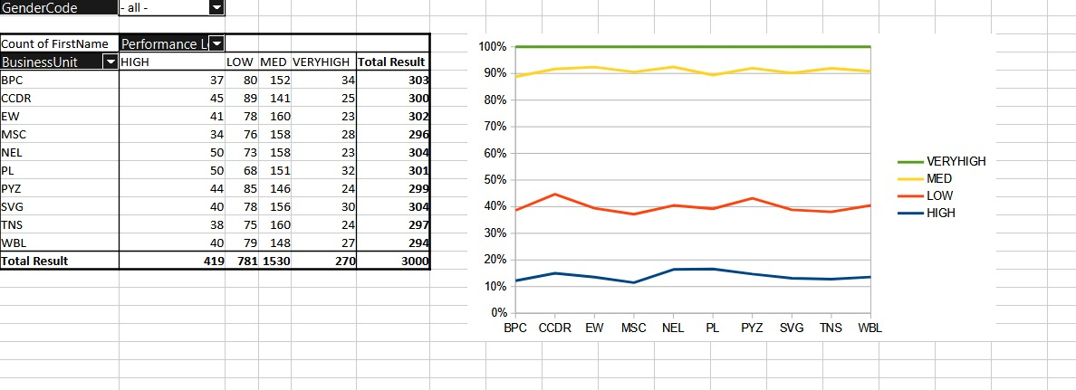
RESULT
<number>

Slide 13
Conclusion
“Employee data analysis provides valuable insights into workforce performance, productivity, and development needs. By leveraging data-driven decision making, organizations can:
Enhance employee engagement and retention
Identify skill gaps and training opportunities
Inform strategic talent management decisions
Optimize performance management processes
Improve overall business outcomes
Effective employee data analysis enables organizations to unlock the full potential of their workforce, drive business success, and maintain a competitive edge in the market.”

